Slide 1



AI-Powered Bots : Intelligent Automation for SAP
By Shweta Soni, S/4HANA Architect & AI Integrations Specialist
Shweta.soni.1@outlook.com @shweta-soni-ai-sap +91-9910822660

Slide 2
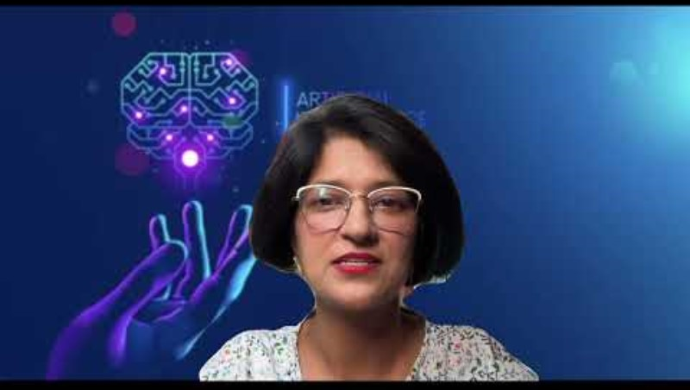
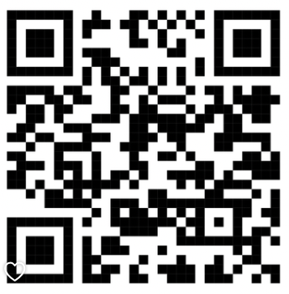
Brief Introduction
Watch Video here !
YouTube Link : https://youtu.be/ZuheuCYE9I8
SCAN ME
Notes:
The Watch Video feature is supported in PPT mode only ! For PDF, please use QR code or the direct link provided .

Slide 3
Intelligent Automation for SAP Purchase Powered by AI
Introducing a revolutionary bot powered by OpenAI to streamline creation of Purchase Orders in SAP . Salient features :
Understands input in natural language
Understands user-specific master & configuration data
Intelligently infers context to derive crucial data based on rules defined
Low-Code No-Code
Watch as it effortlessly creates and posts payloads to the SAP OData service transforming the way you manage your backend processes. Dive into the demo to see how this prototype not only simplifies but also accelerates your SAP operations.

Slide 4
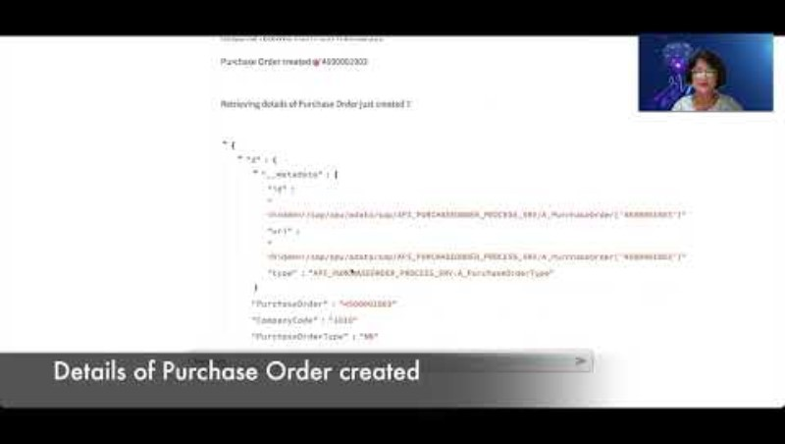

SAP Purchase Assistant Bot
Watch Video here !
YouTube Link : https://youtu.be/_JoCTHLbJUU
SCAN ME
Notes:
The Watch Video feature is supported in PPT mode only ! For PDF, please use QR code or the direct link provided .

Slide 5
Intelligent Automation for SAP Purchase Powered by AI (Automated via file)
In today's era of automation, the ability to process inputs via email or files is essential. Introducing a bot powered by OpenAI, designed to revolutionize the creation of Purchase Orders in SAP using the same. Key features include:
Capability to upload files for input
Natural language understanding
Utilization of user-specific master & configuration data
Intelligent context inference to extract crucial data based on rules defined
Low-Code No-Code
Watch as it effortlessly creates and posts payloads to the SAP OData service transforming the way you manage your backend processes. Dive into the demo to see how this prototype not only simplifies but also accelerates your SAP operations.

Slide 6
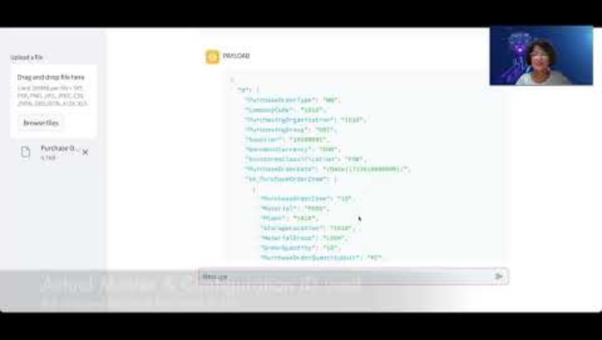
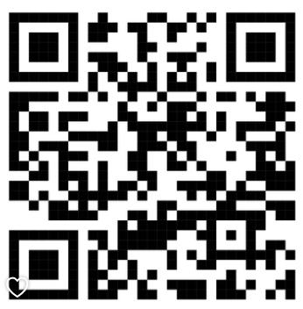
SAP Purchase Assistant Bot (Input Automated by File)
Watch Video here !
YouTube Link : https://youtu.be/tXVRnZDpswI
SCAN ME
Notes:
The Watch Video feature is supported in PPT mode only ! For PDF, please use QR code or the direct link provided .

Slide 7
Intelligent Automation for SAP Supplier Powered by AI
Building an App for creation of supplier has several challenges in terms of complexity, build effort, user interface, and business rules to name a few. OpenAI GPT-4 has brought this complexity significantly down. This video is about a prototype built using the same. Salient features :
Converses in natural language
Understands user-specific master and configuration data
Low-Code No-Code
Flexible Format for input
Intelligently infers context to derive crucial data based on rules defined
Watch as it effortlessly creates and posts payloads to the SAP OData service transforming the way you manage your backend processes. Dive into the demo to see how it not only simplifies but also accelerates your SAP operations. This prototype focuses on creation of supplier in Germany.

Slide 8
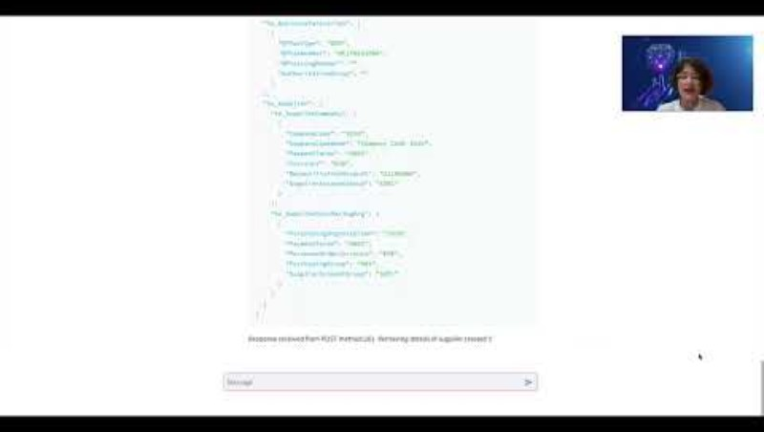

SAP Supplier Assistant Bot
Watch Video here !
YouTube Link : https://youtu.be/DKCwFVsL8j8
SCAN ME
Notes:
The Watch Video feature is supported in PPT mode only ! For PDF, please use QR code or the direct link provided .

Slide 9
Special Feature on Automation Intelligence - Dual OpenAI Assistants !
Can we get the functionality and the processing power of two OpenAI assistants in one App. Yes, it's possible !
Dive into this unique demo where two OpenAI assistants (links given below ) works seamlessly together in a LCNC App taking user experience to a new level.
This prototype is composed of below Assistants such that the user gets to use them interchangeably without any extra effort :
Intelligent Automation for SAP Purchase Powered by AI
Intelligent Automation for SAP Supplier Powered by AI

Slide 10
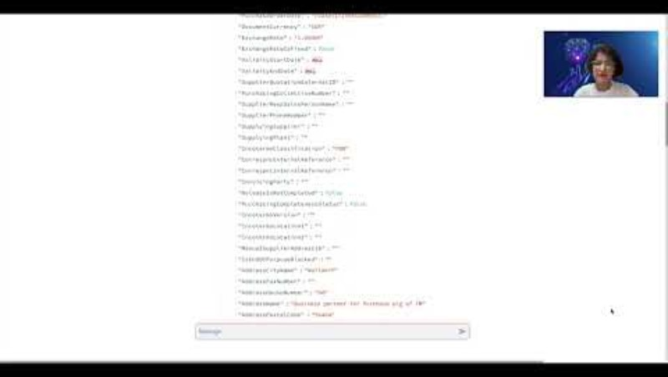

Integration of Dual OpenAI Assistants!
Watch Video here !
YouTube Link : https://youtu.be/Ls2fC_8d6NY
SCAN ME
Notes:
The Watch Video feature is supported in PPT mode only ! For PDF, please use QR code or the direct link provided .

